Slide 1
Astor: Exploring the Design Space of Generate-and-Validate Program Repair beyond GenProg
Matias Martinez , Martin Monperrus
2020-08-13
JuHyoung Kim
kjhkjh75@naver.com

Slide 2
- Research Goal
Improve the efficiency of validation.
Can we match the fit techniques?

Slide 3
- Introduction
The main goal is to reduce cost and time of software maintenance
Astor is a program repair framework for Java, it provides 6 generate and validate repair approaches.
Contribution
The explicit design space of generate-and-validate program repair
The realization of that design space in Astor
Twelve extension points, which program repair researchers can either reuse or extend for doing research
6 repair approaches that can be used.
Evaluation of two extension points of GenProg : ingredient space and transformation.

Slide 4
- Architecture
Astor encodes the design space of generate-and-validate repair approaches
- generate a set of patches
- validate using a correctness oracle.
Astor provides twelve extension points that form the design space of generate-and-validate program repair.
Main design decisions are
a) code transformation (repair operators) used to define the solution
search space
b) different strategies for navigating the search space of candidate
solutions
c) mechanism for validating a candidate solution.

Slide 5
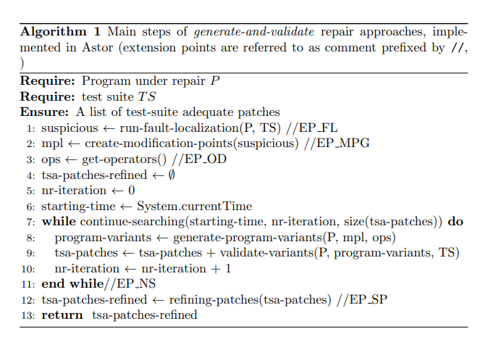
- Architecture
Generate and validate repair approach
Fault localization
Creation of a representation
Navigation of the search space
Solution post-processing

Slide 6
- Architecture
Fault localization
- Astor use fault localization techniques based on spectrum analysis
- Those techniques execute the test cases of a buggy program and trace the execution of software components(method , line)
- From the collected traces and the tests results ( fail or pass), techniques use formulas to calculate the suspicious
- 0~1 suspicious value
- researchers can plug implementations of any fault localization technique

Slide 7
- Architecture
Identification of Modification Points
- FL returns a list of suspicious code location(statement)
- Astor creates modification points from above results.
jGenProg -> creates one modification point per each statement indicated as suspicious by the fault localization.
Cardumen -> creates a modification point for each expression
jMutRepair ->creates a modification point for expression with unary and binary operators.

Slide 8

- Architecture
jGenProg creates two modification points (statements line10,11)
Cardumen creates 3 modification points
1 ) assignment at line 10
2 ) method invocation at 11
3 ) expression (previousMonth + currentMonth)

Slide 9
- Architecture
Creation of repair operators
- Synthesis and repair operators
synthesize new code by directly applying one transformation operators to a modification point, without extra information.
ex) (fa * fb) > 0.0 -> (fa * fb) >=0.0
- Synthesis based on ingredients
Operators that need some extra information before applying a code transformation in a modification point
ex) two operators(Insert and Replace) need one statement
taken from somewhere
Ingredient-based approaches.

Slide 10
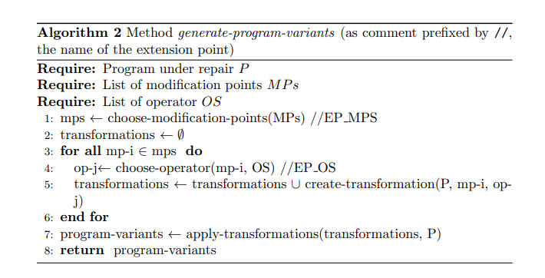
- Architecture
Navigation of the search space
- Goal is to find, between all possible modified versions of the buggy program , which do not contain the bug.
In each iteration, verifies whether a set of code changes done by repair operators repair the bug - > program variant.
Astor computes a candidate patch from program variant

Slide 11
- Architecture
Generation of Program variants
- Selection of modification points.
- Selection of repair operators
Each selected modification point, approach selects one repair
operator
- Creation of code transformation
Groups a modification point and a repair operator
1) Astor first detects if the operator need ingredients or not
2) Not, returns the transformation composed by the mP and OP
3) Otherwise, creates the ingredient pool
4) Operator can use ingredient directly(without any transformation)
5) or transformation proposed in case ingredients not in the scope

Slide 12
- Architecture
Candidate patch validation
- Astor synthesizes from each variant
- validation process to be used
- No failing test cases -> correct
- Fitness Function is used to determine if a patch is a solution or not
by default, Astor count the number of failing test cases.

Slide 13
- Architecture
Evaluation of conditions for ending navigation
- stop the loops when any of conditions is fulfilled
a) finding n plausible patches
b) iterating n times
c) executing during h hours(timeout)
Solution post-processing
- Two kinds of post-processing
1) removing program variant not related to the bug fixing
keeping only those are necessary to repair the bug.
2) sorting patches according to a given criterion

Slide 14
- Extension points provided
Fault Localization
- Implemented components
1) Gzoltar
2) CoCoSpoon
3) Custom
- 0 (very low suspicious) ~ 1 (highest suspicious)
Granularity of Modification points
-Implemented components
1) Statements
2) Expression
3) Logical-relational-operators (and,or,>,etc)
4) Custom

Slide 15
- Extension points provided
Navigation Strategy
- Implemented components
1) Exhaustive : complete navigation
2) Selective : partial navigation by default, by random steps
3) Evolutionary: navigation using genetic algorithm
4) custom
- Exhaustive navigation
all the candidate solutions are considered and validated
- Selective navigation
Uses weight random for selecting modification points,
where the weight is the suspiciousness value
Uniform random for selecting operators.

Slide 16
- Extension points provided
Selection of suspicious modification points
- Implemented components
1) uniform-random
every modification same probability to be selected
2) Weighted-random
the probability of modification point depend on the
suspiciousness of the pointed code
3) Sequential
according to the suspiciousness value, in decreasing order

Slide 17
- Extension points provided
Operator spaces definition
- IRR-Statements : insertion, removement ,replacement of statements
- Relational-Logical-Operators : change of unary operators and logical relational binary operators.
- Suppression : change of if conditions by True or False value, insertion of remove statement
- R-expression : replacement of expression by another expression

Slide 18
- Extension points provided
Selection of repair operator
- Uniform-random : every repair operator has the same probability
- Weighted-random : Each repair operator has a particular probability

Slide 19
- Extension points provided
Ingredient pool definition
- File : pool with ingredients written in the same file
- Package : pool with ingredients written in the same package
- Global : pool with all ingredients from the application
In jGenProg the ingredient pool contains all the statements from the application under repair
jGenProg replace or add a statement

Slide 20
- Extension points provided
Selection of ingredients
- Uniform-random : ingredient randomly chosen
- Code-similarity-based : ingredient chosen from similar methods
to the buggy method
- Name-probability-based : ingredient chosen based on the frequency of its variable`s names.
jGenProg uses uniform random selection
DeepRepair uses similarity from methods

Slide 21
- Extension points provided
Ingredient transformation
- No-transformation
- Random-variable-replacement : out-of-scope variables from an ingredients are replaced by randomly chosen in-scope variables.
- Name-cluster-based : out-of scope variables from an ingredients are
replaced by similar named in-scope variables.
- Name-probability-based : out-of-scope variables from an ingredients are replaced by in-scope variable based on the frequency of variable`s names

Slide 22
- Extension points provided
Deep Repair replaces out of scope variables based on a cluster of variable names (semantically related names)
Cardumen uses a probabilistic model based on frequency.
jGenProg does not transform any ingredient.

Slide 23
- Extension points provided
Candidate Patch Validation
- Test suite : original test-suite
- Augmented-test-suite : new test cases are generated for augmented the original test suite used for validation’
Through additional test case can prevent overfitting patch.
Sorts the generated patches by prioritizing with less failures over the new tests.

Slide 24
- Extension points provided
Fitness Function for evaluating candidate
- Number-failing-tests

Slide 25
- Extension points provided
Solution prioritization
- chronological : according with the time discovered.
- Less-regression : the number of failing cases , in ascending order

Slide 26
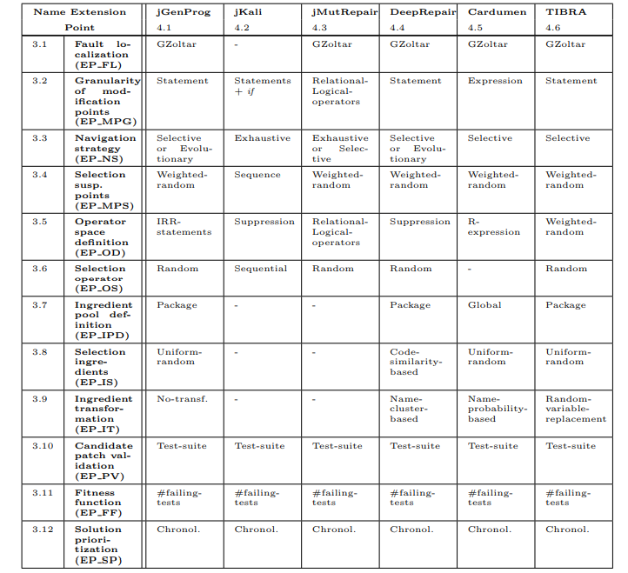
- Repair Approaches implemented

Slide 27
- Evaluation
RQ 1.1 – How many bugs from Defects4J are repaired using the repair approaches
- Astor 98 real bugs out of 357 bugs from Defects4J.
- Best approach is Cardumen, 77 bugs.
(jGenProg (49 bugs repaired), jKali (29), jMutRepair (23), DeepRepair (51), Cardumen (77), and TIBRA (35). )

Slide 28
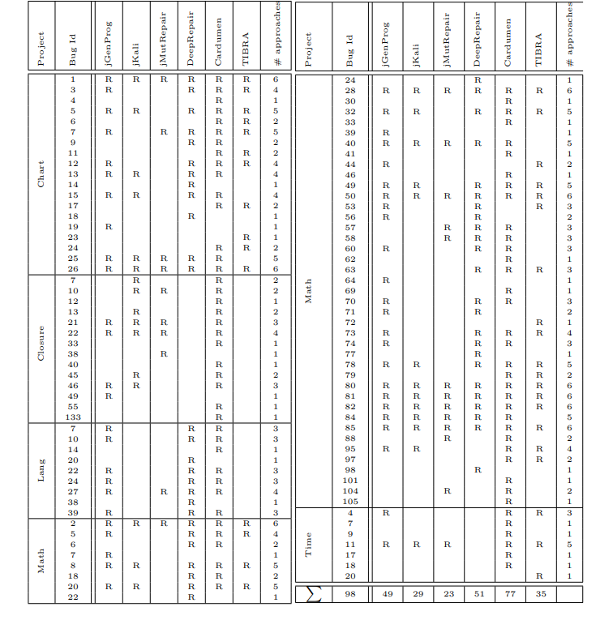
- Evaluation
RQ 1.2 – What are the bugs uniquely repaired by approaches?
- Astor repair 11 bugs which have never been repaired previously

Slide 29
- Evaluation
RQ 1.3 - Which code granularity repairs more bugs?
- Compared the extensions statements and expression implemented in jGenProg(72) and Cardumen(77)
- 52 patches repaired by both
- remaining bug(20, 25) respectively

Slide 30
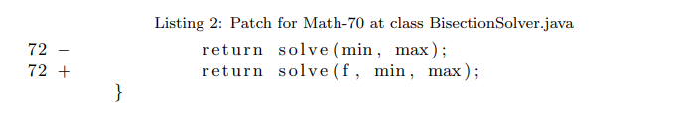

- Evaluation
jgenProg : O Cardumen : O
jgenProg : X Cardumen : O

Slide 31
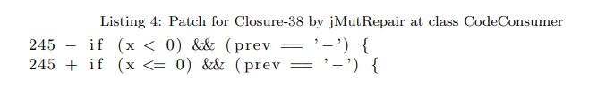
- Evaluation
- Only repaired for jMutRepair

Slide 32
- Evaluation
RQ 2.1 -To what extent does a reduced ingredient space impact repairability?
- File and Package ingredients pools found more test-suite adequate patches and faster (reduction of 22 minutes an average) than the Global
RQ 2.2 - To what extent does the ingredient transformation strategy impact repairability?
- Compared three extensions : no-transformation, cluster

Slide 33
- Future work
Prove possibility of code pattern and match the technique

